Slide 1
Unit 4
Lecture 4

Slide 2
Multiplexers
A digital multiplexer is a combinational circuit that selects binary information from one of many input lines and directs it to a single output line.
The selection of a particular input line is controlled by a set of selection lines.
Normally, there are 2^n input lines and n selection lines whose bit combinations determine which input is selected.

Slide 3
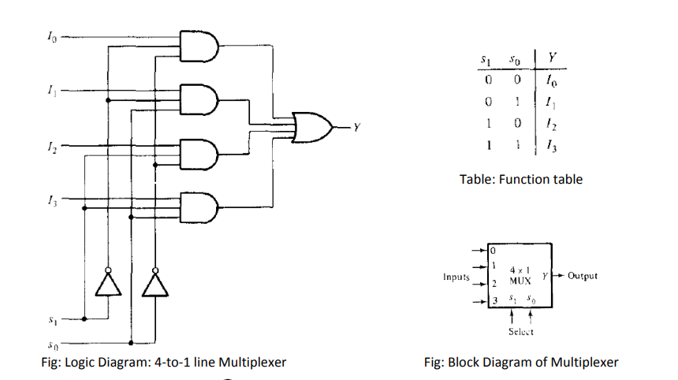

Slide 4
Demultiplexer
A demultiplexer is a circuit that receives information on a single line and transmits this information on one of 2^n possible output lines.
The selection of a specific output line is controlled by the bit values of n selection lines.
A Decoder with an enable input can function as a demultiplexer.
Here, enable input and input variables for decoder is taken as data input line and selection lines for the demultiplexer respectively.

Slide 5
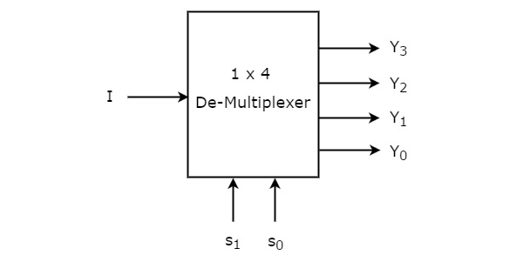
1x4 De-Multiplexer
1x4 De-Multiplexer has one input I, two selection lines, s₁ & s₀ and four outputs Y₃, Y₂, Y₁ &Y₀. The block diagram of 1x4 De-Multiplexer is shown in the following figure.

Slide 6
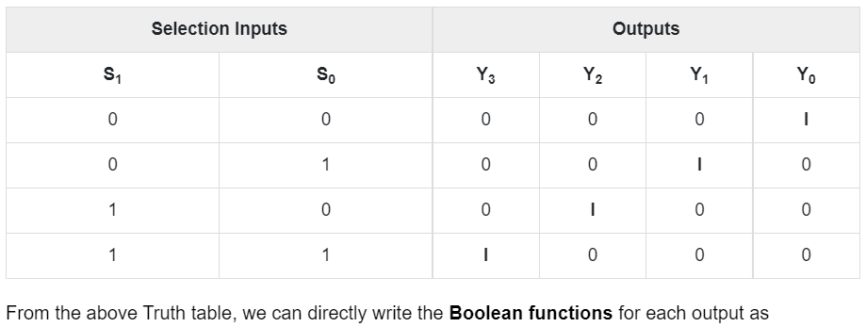
The single input ‘I’ will be connected to one of the four outputs, Y₃ to Y₀ based on the values of selection lines s₁ & s0. The Truth table of 1x4 De-Multiplexer is shown below

Slide 7
Y3=s1s0IY3=s1s0I
Y2=s1s0′IY2=s1s0′I
Y1=s1′s0IY1=s1′s0I
Y0=s1′s0′I
From the above Truth table, we can directly write the Boolean functions for each output as
Y3= S1 S0 I
Y2= S1 S0’ I
Y1= S1 ’ S0 I
Y0=S1 ’ S0 ’ I

Slide 8
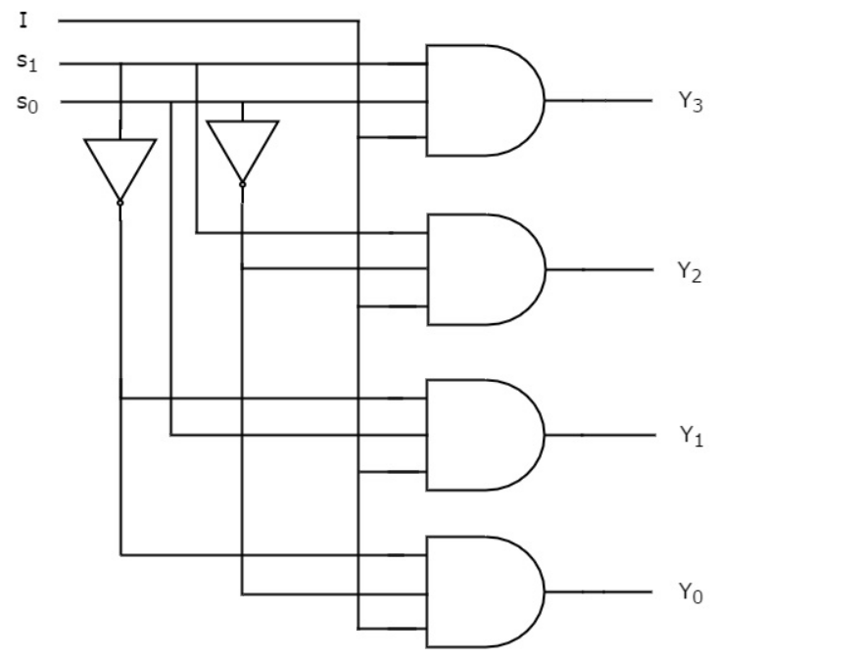
Fig: Logic Diagram

